Slide 2
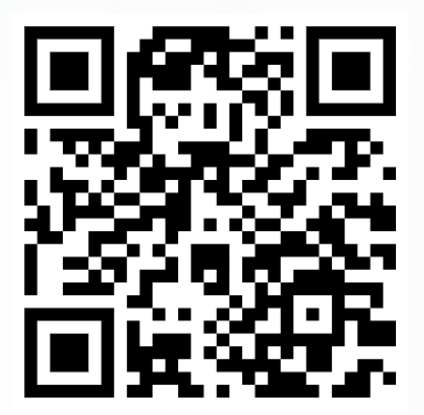
Join Medical-Surgical Nurses at the 2025 AMSN Convention
Sept. 11-13, 2025 | Hilton Austin | Austin, Texas
2 Pre-Convention Workshops
Peripheral IV Insertion Hands-On Workshop
Showcasing Your Scholarship: Writing for Publication
Discounted registration rates for AMSN Members (more information on the registration page)
Earn up to 15.75 contact hours by attending sessions that follow 7 different education tracks
Scan the QR code to register:

